Slide 1
Employee Turnover Predictor
Final Presentation
Liban Dahir · Logan Simba · Ahmad Mouhsen

Slide 2
Problem and Goal
Turnover is expensive and often detected too late.
Managers need early risk signals, not just historical reports.
Goal: Predict turnover risk and guide targeted retention actions.

Slide 3
System Overview
Inputs: employee profile + behavioral/context factors from turnover.csv.
Output: risk score (0 to 1) and risk level (Low/Medium/High).
UI supports filtering, at-risk review, and scenario-based prediction.

Slide 4
Requirements Summary
Functional
• Import employee data (CSV/Excel).
• Predict turnover risk for each employee.
• Filter by department, tenure, and risk level.
• Generate retention recommendations.
Non-Functional
• Readable UI for non-technical users.
• Fast response for interactive filtering.
• Maintainable modular architecture.
• Secure and responsible handling of HR data.

Slide 5
Data and Features
Dataset: turnover.csv (1,129 records, 16 fields).
Target: event (1 = leave, 0 = stay).
Key features: tenure, role/department, coaching, compensation, anxiety, self-control, independence.

Slide 6
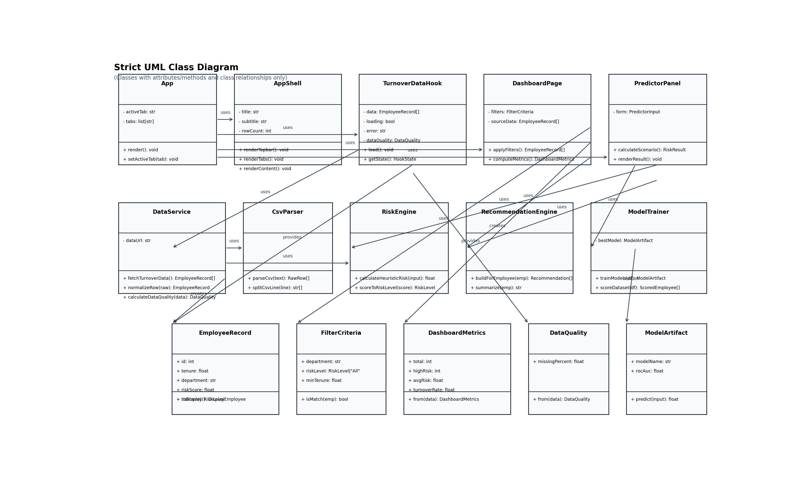
Class Diagram
• Three-layer class structure: UI, Service, and Data objects.
• Clear class responsibilities and method boundaries.
• Dependencies are explicit to keep the system maintainable.

Slide 7
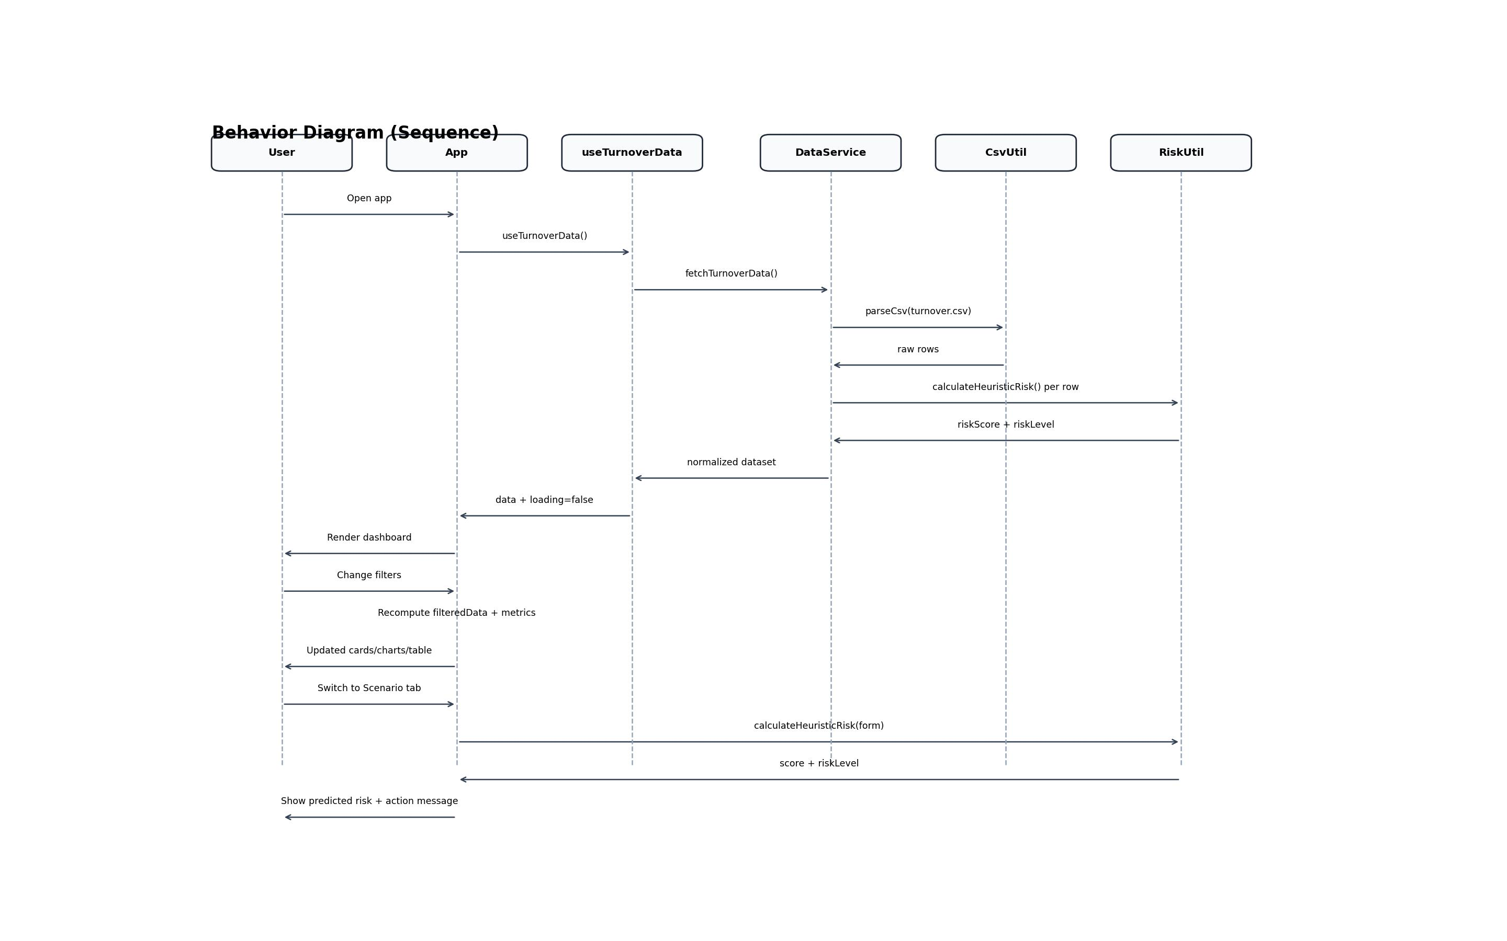
Behavioral Diagram
• Shows end-to-end runtime flow from app open to prediction.
• Solid arrows are calls; dashed arrows are returns.
• Conditional paths cover filters and scenario predictions.

Slide 8
Machine Learning Pipeline
1) Preprocess: clean missing values and encode categorical fields.
2) Split data into training and test sets.
3) Train Logistic Regression and Random Forest models.
4) Select best model by ROC-AUC and score each employee.

Slide 9
Risk Scoring and Decision Support
Low: score < 0.40 · Medium: 0.40 to 0.69 · High: >= 0.70.
High-risk employees are surfaced with action-focused recommendations.
Model output is decision support, not automatic HR decision-making.

Slide 10
Implementation Status and Demo Plan
Implemented
• Working Streamlit dashboard with model training and risk analytics.
• React frontend prototype with cleaner UI and plain-English labels.
• Class and behavioral diagrams aligned to system design.
Live Demo Flow (Tomorrow)
• Load data and show summary KPIs.
• Filter by department and review high-risk employees.
• Run a scenario prediction and explain resulting recommendations.

Slide 11
Limitations and Next Steps
Current model depends on historical data quality and coverage.
Next: strengthen testing, CI/CD, and explainability dashboards.
Future: fairness checks and longitudinal outcome tracking.

Slide 12
Questions
Discussion
Thank you.

